Slide 1

The 8-bit CPU
KWAME NKRUMAH UNIVERSITY OF SCIENCE AND TECHNOLOGY
KUMASI, GHANA
Group 10
Computer Engineering

Slide 2

OUTLINE
Introduction
Main Components
Schematics
The ISA
Conclusion
KNUST
1

Slide 3
Introduction
All computers have central processing unit (CPU). It is responsible for executing and processing data correctly. It performs a fetch-decode-execute cycle on the right data.
We are going to explore the inner workings of the 8-bit CPU we built and the various components that it is made up of.
This CPU was built using the von Neumann architecture.
KNUST
2

Slide 4
Main Components
Arithmetic logic unit
Control Unit
Memory unit
KNUST
3

Slide 5
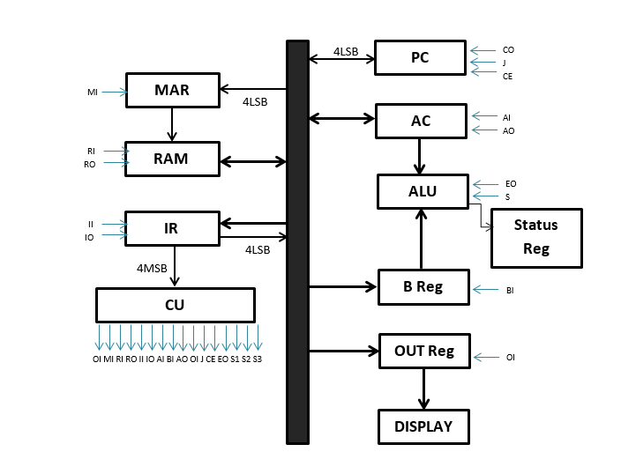
Schematics
KNUST
4

Slide 6
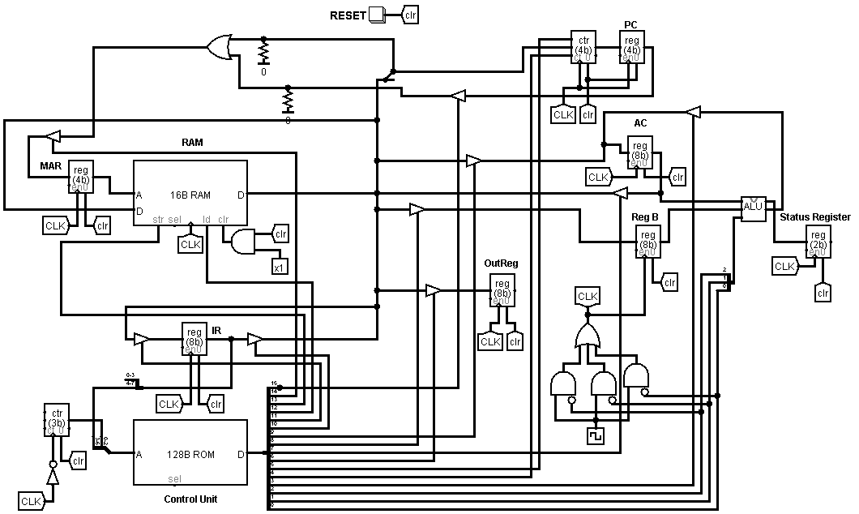
Schematics cont.
Detailed view
KNUST
5

Slide 7
The ISA
Instruction | Mnemonic | Opcode
Load | LD | 0001
Store | ST | 0010
Add | ADD | 0011
Subtract | SUB | 0100
Multiply | MUL | 0101
Divide | DIV | 0110
Jump | JMP | 0111
Halt | HLT | 1000
Out | OUT | 1001
OR | OR | 1010
AND | AND | 1011
NOT | NOT | 1100
KNUST
6

Slide 8
Conclusion
This CPU implements microprogramming which is basically a program which asserts control lines so that a particular task will be carried out.
So the instructions are input into a microprogram which converts the instructions into control lines.
For the purpose of this CPU the microcode for the program (interpreter) is placed in a ROM.
KNUST
7

Slide 9
THANK YOU

